Slide 1
Experiment Design

Slide 2
Motivation
Multiple observer metamerism failure indices (OMFIs)
Adjustable parameters in OMFIs
White point for DE2000
DE2000 or DEITP
Central tendency or dispersion of errors as final output
Similar to experiments underlying DE2000
DE2000(CIELab₁, CIELab₂)
OMFI(SPD₁, SPD₂)

Slide 3
Experiment Basics
Goal: collect data needed to determine which OMFI matches our real world experience
4-6 displays with differing emission spectra
Preferably include a laser projector
30+ observers
Professionals with color evaluation experience
Dark or dim surround
Spectrometers
Preferably 1 for each display

Slide 4
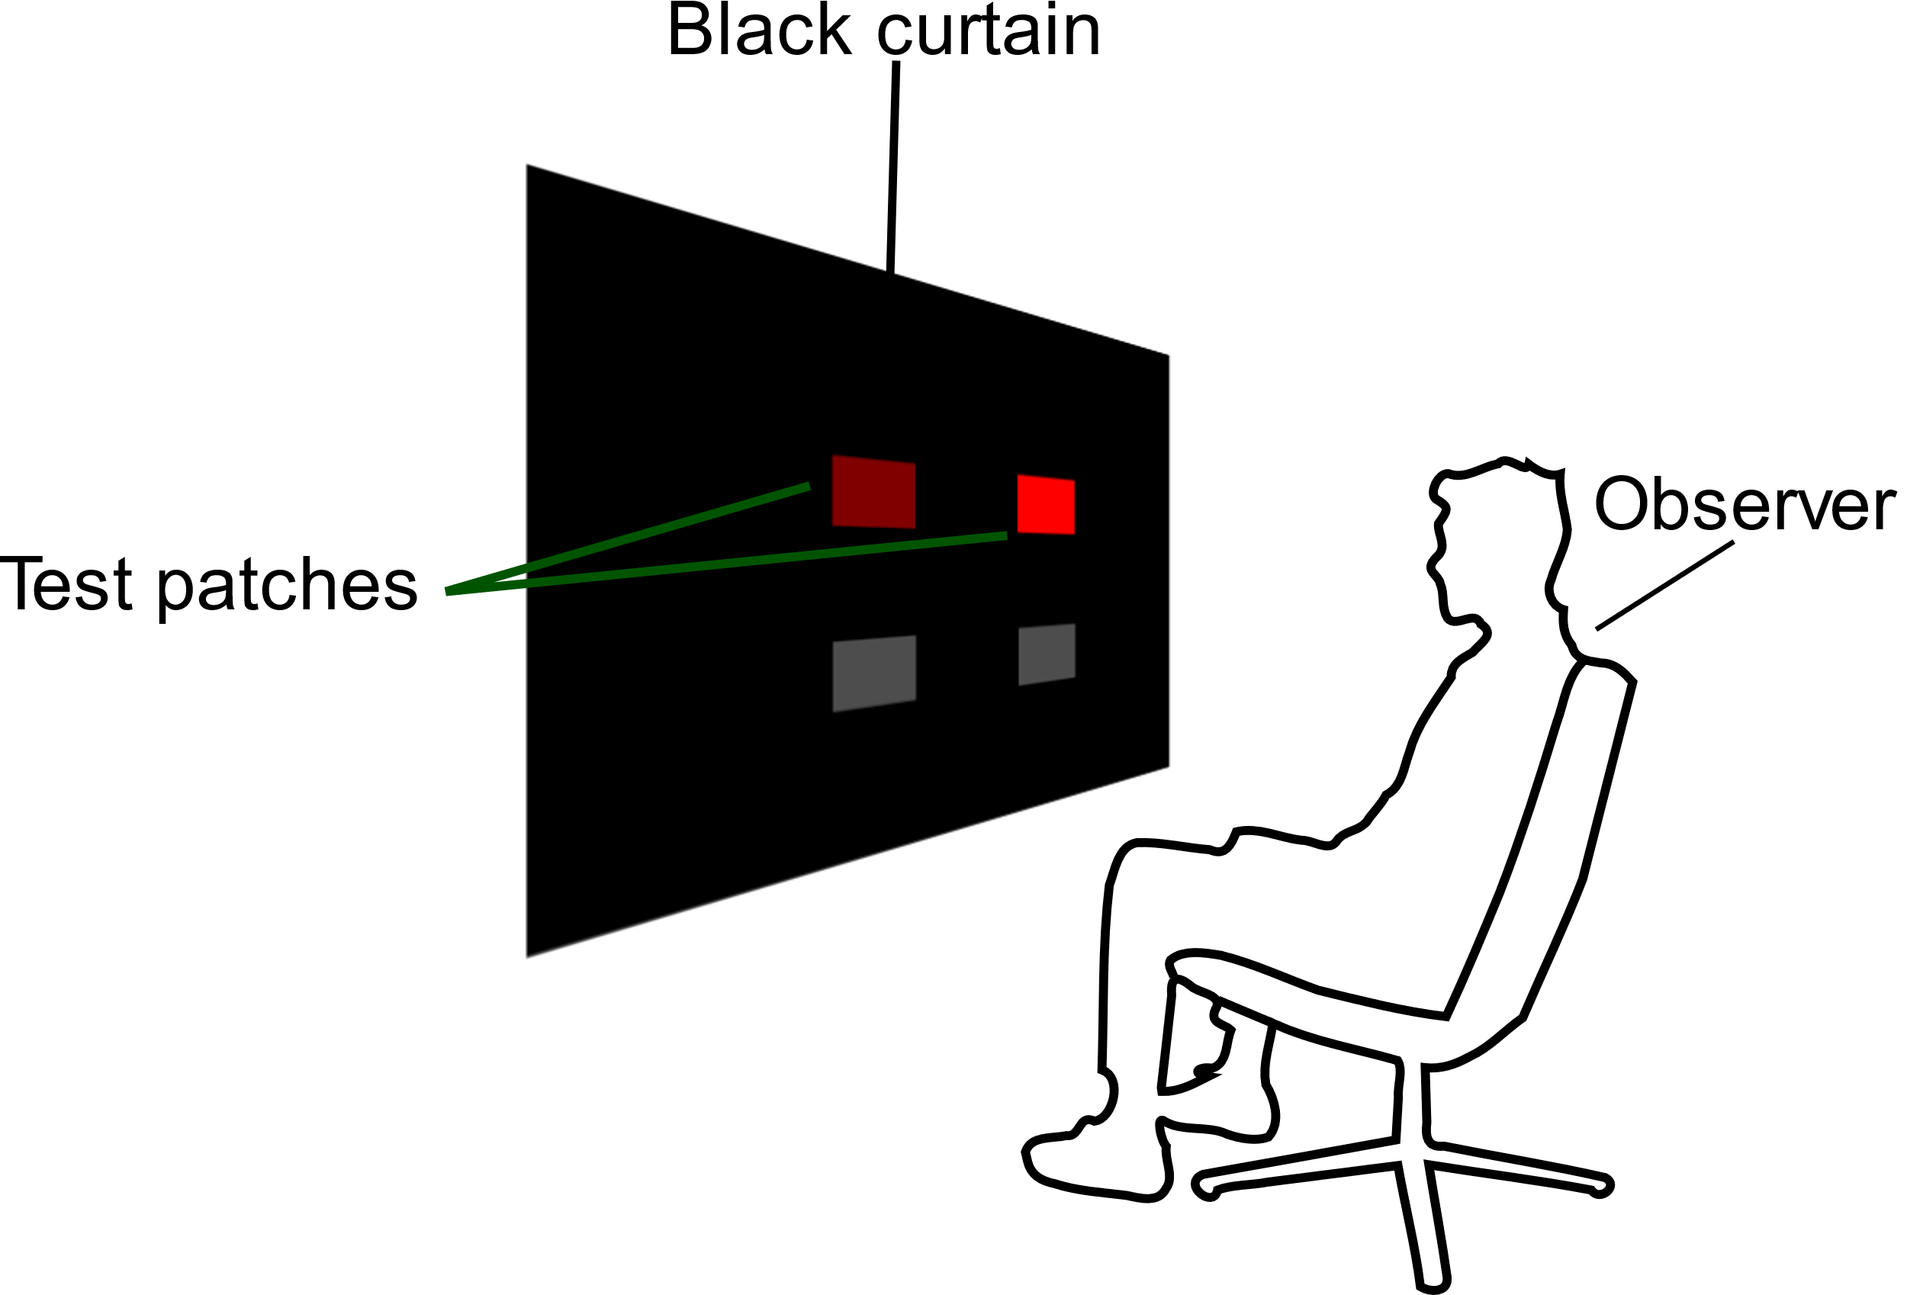
Experimental Setup (Side View)

Slide 5
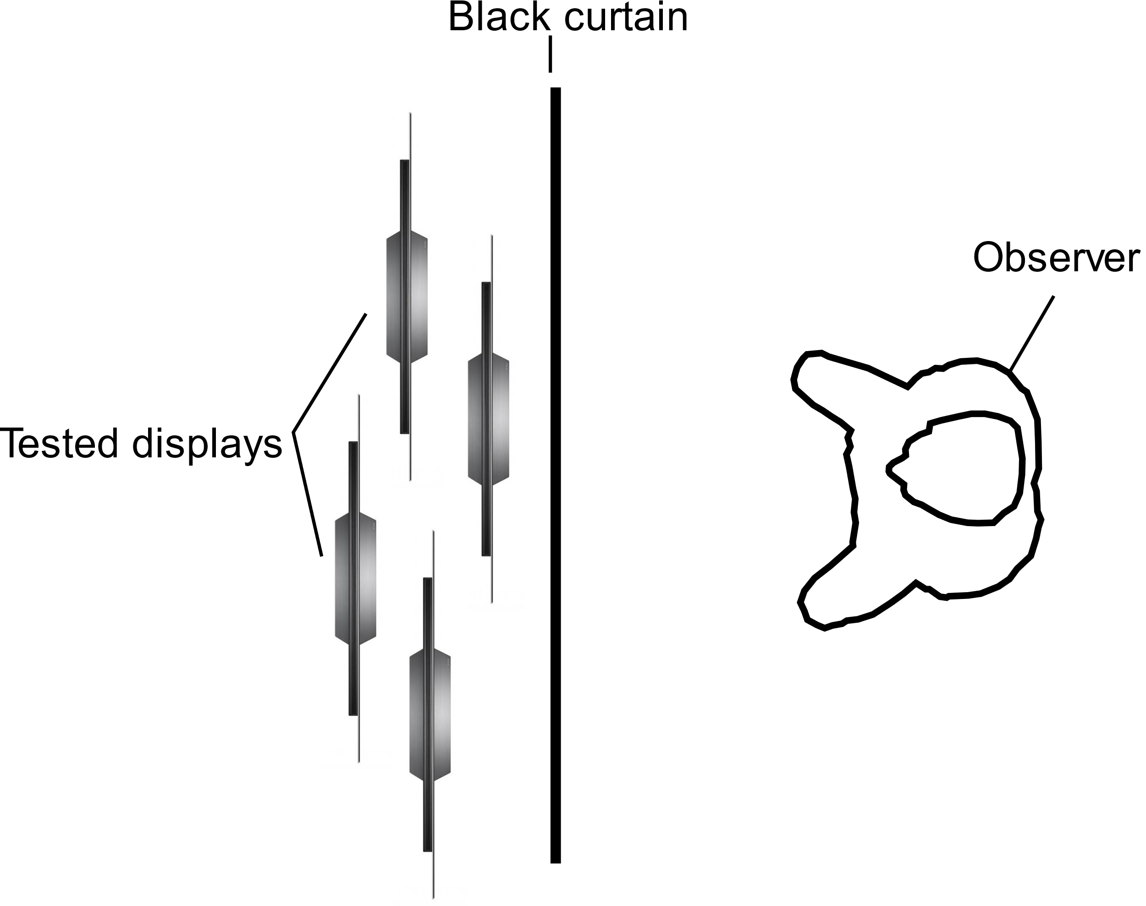
Experimental Setup (Top View)

Slide 6
Experimental Procedure
Explanation of the experiment goals and collection of observer data
Adaptation period
Training session
Main experiment loop – repeated until all evaluations are completed
Automatic patch adjustment to match desired CIE 31 XYZ (Optional)
Stimulus presentation
User input recording
Patch spectra measurement (Optional)
Short pause in stimuli presentation

Slide 7

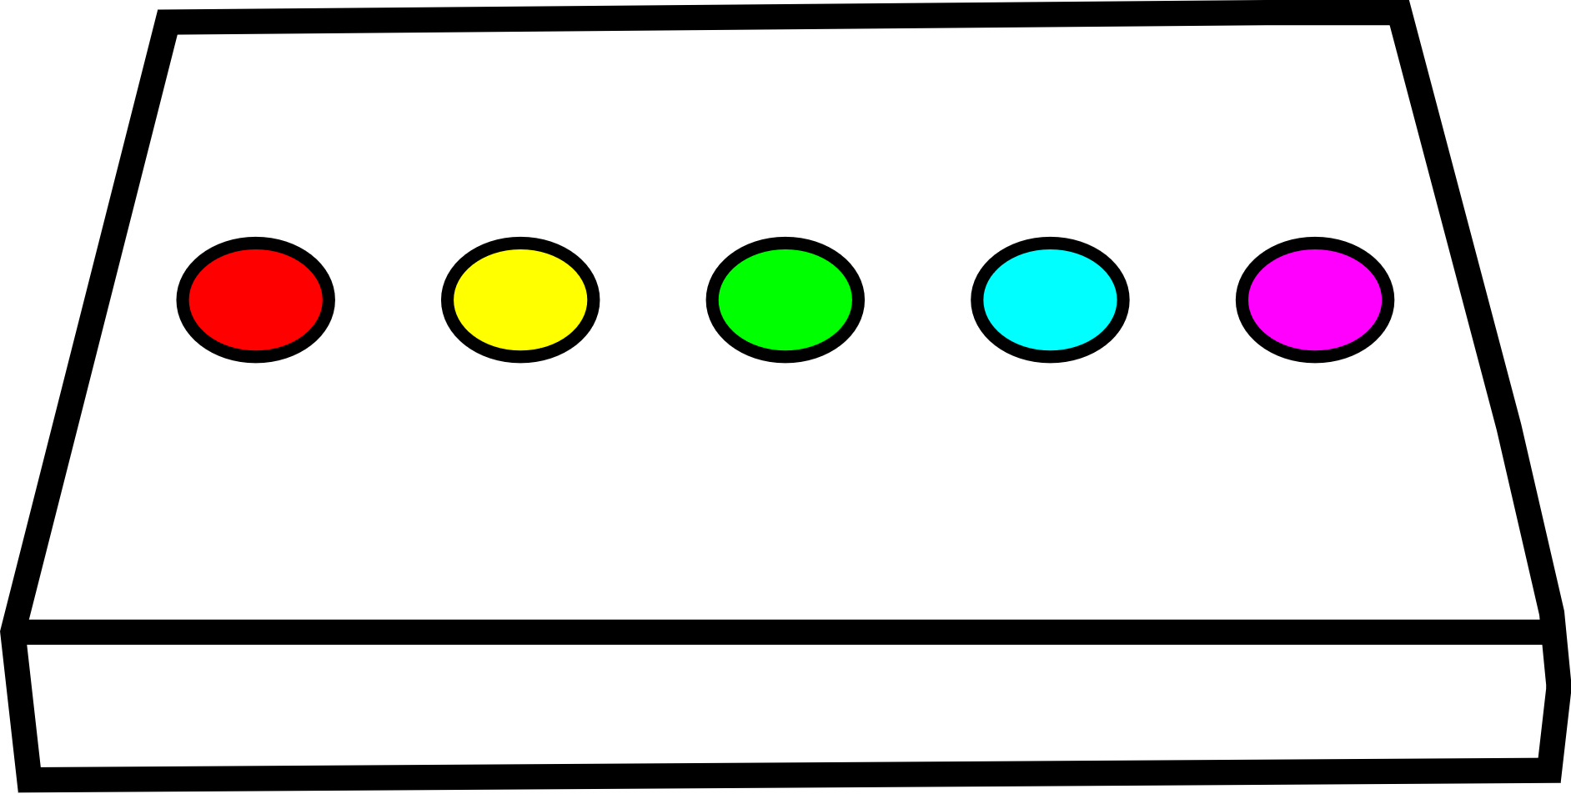
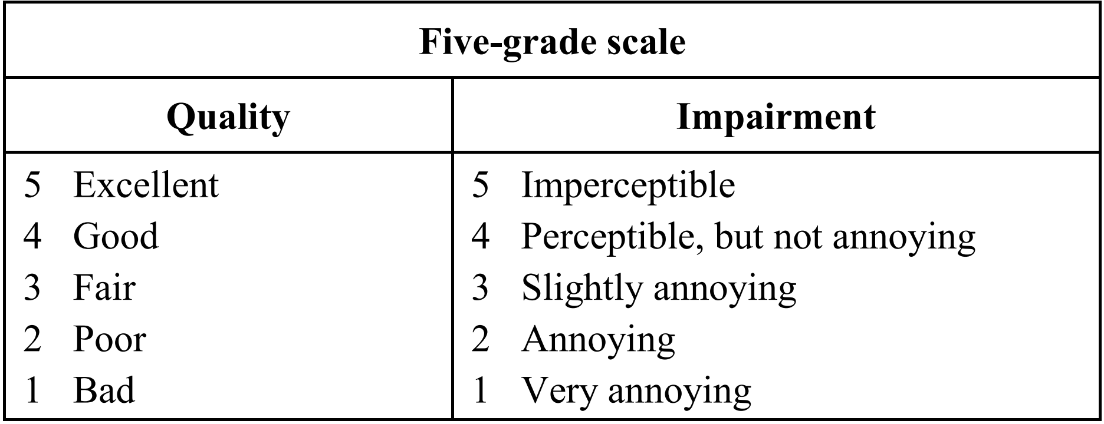





Experimental Procedure – Input Recording

Slide 8
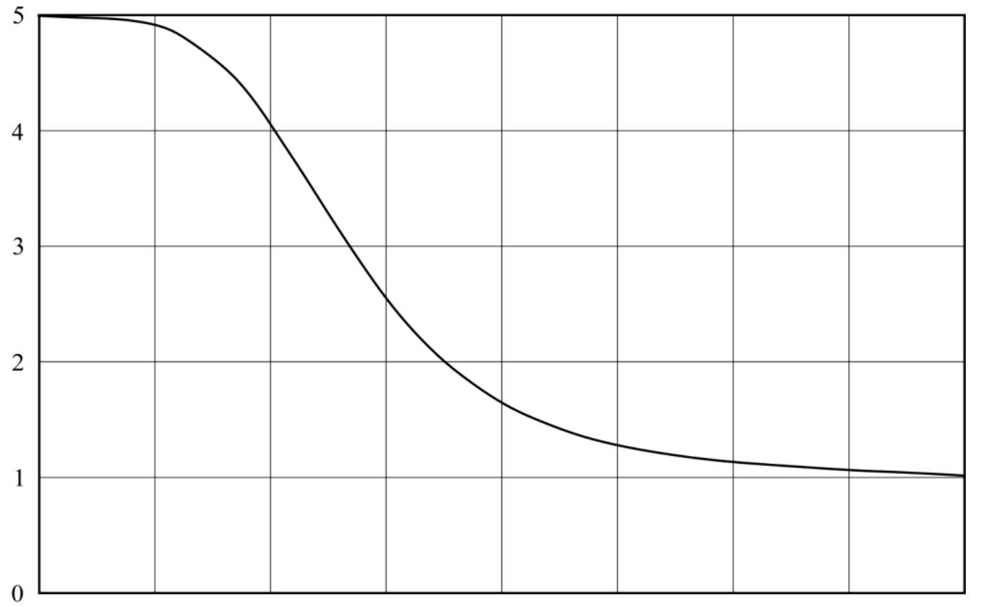
Data Fitting – Logistic Regression Using MLE
Good Fit
Bad Fit
Observer
Score
OMFI1
OMFI2

Slide 9
Fit Evaluation
Use several quality of fit measures:
Pearson Correlation
Spearman Rank Test
Wald test
Likelihood-ratio test
Suggest the best performing OMFI as the preferred one

